Slide 1
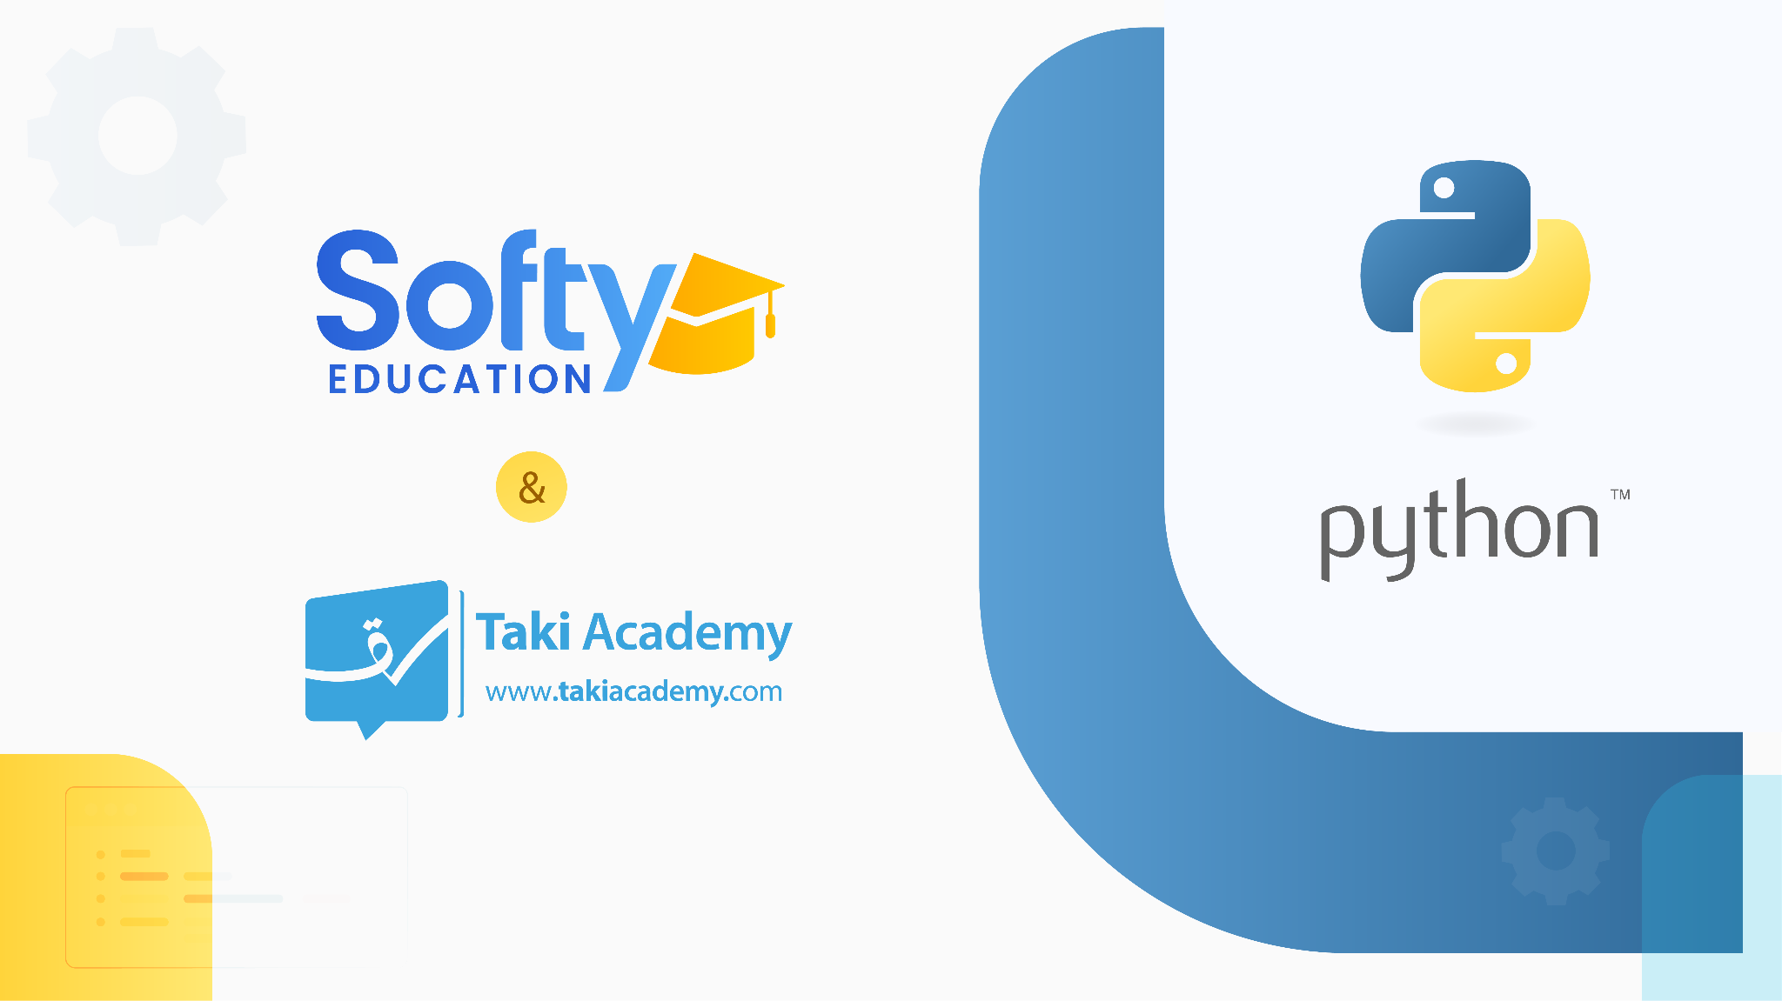
contact@softyeducation.com

Slide 2
Web Scraping

Slide 3
Content :
Introduction to HTML
Python Modules
Introduction to Web Scraping

Slide 4
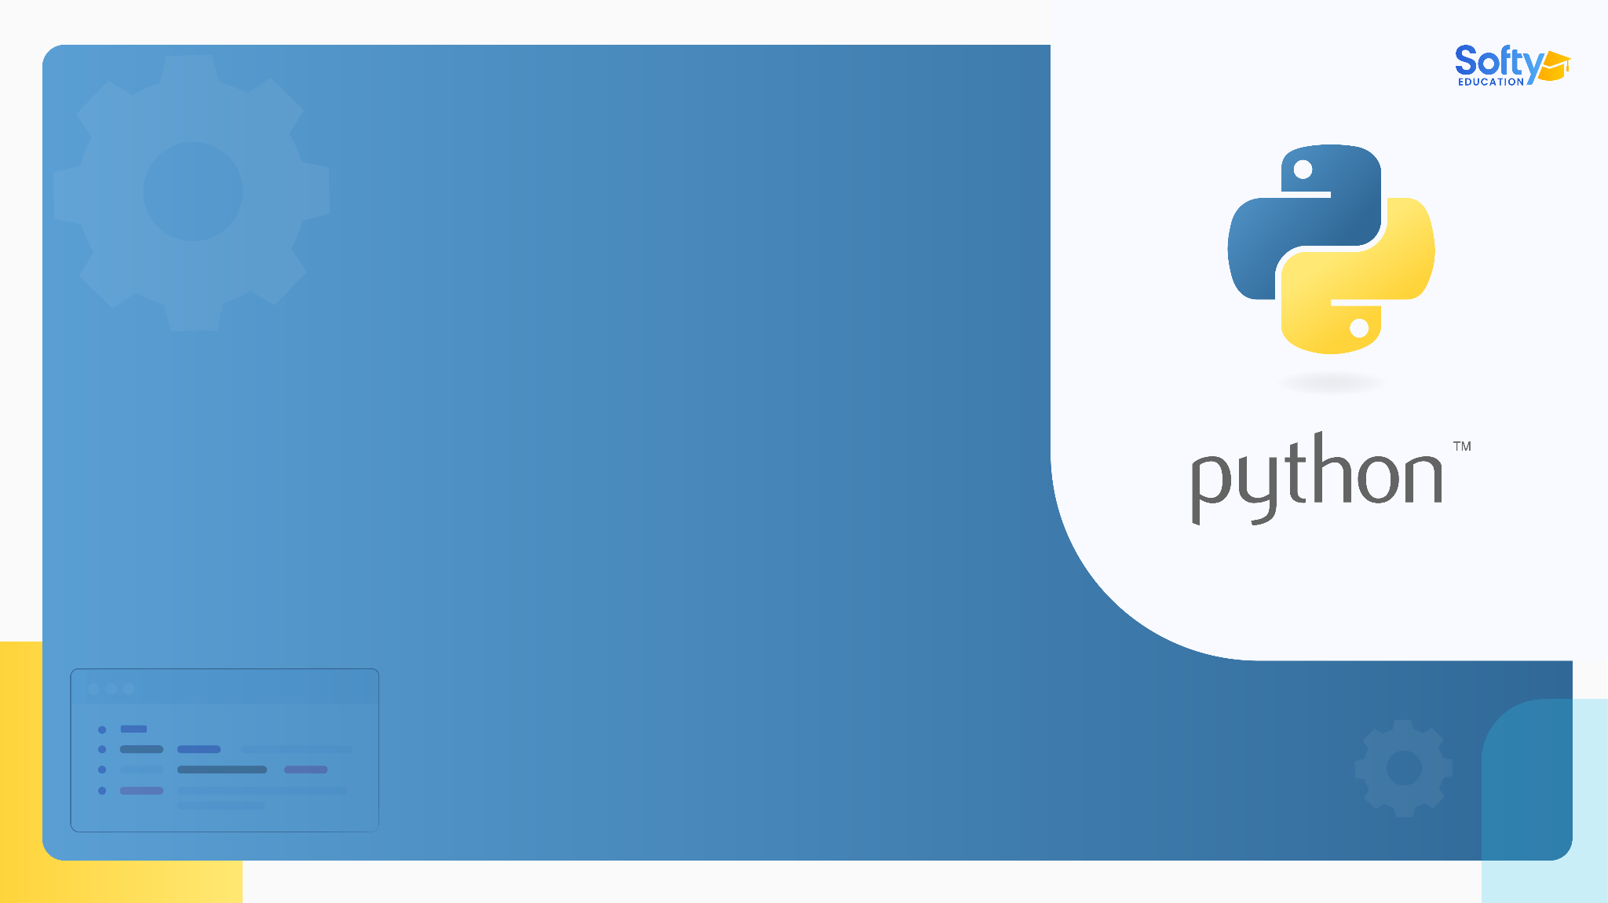
01
Introduction to HTML

Slide 5

01 - Introduction to HTML
What is HTML?
HTML stands for HyperText Markup Language. It's the standard language for creating web pages. When you visit a website, you're essentially viewing a rendered version of the HTML code of that page. Web browsers like Chrome, Firefox, and Safari interpret this code to display the site's content.
‹#›

Slide 6
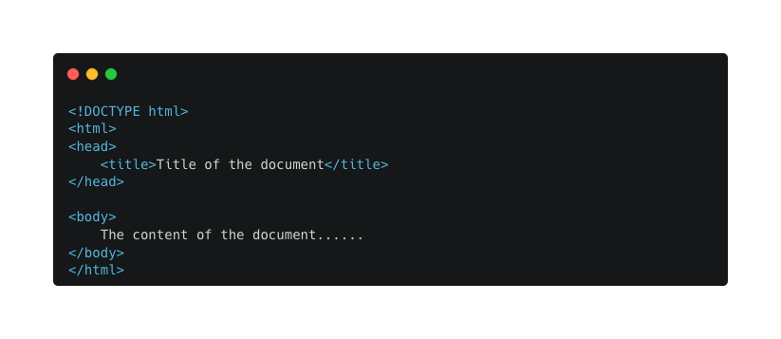
01 - Introduction to HTML
Basic Structure
Every HTML document has a similar basic structure:
‹#›

Slide 7
01 - Introduction to HTML
<!DOCTYPE html>: This declaration defines the document to be HTML5.
<html>: The root element of an HTML page.
<head>: Contains meta-information about the document.
<title>: Specifies a title for the web page, which you'll see on the browser's title bar or tab.
<body>: Contains the visible page content.
‹#›

Slide 8
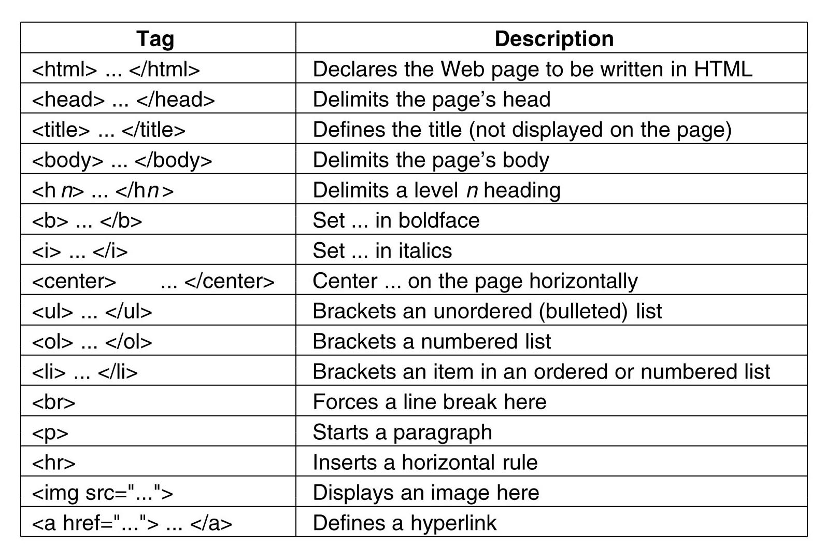
01 - Introduction to HTML
‹#›

Slide 9
01 - Introduction to HTML
Why is HTML Important for Web Scraping?
When you're web scraping, what you're actually doing is parsing the raw HTML of a web page to extract the data you need. Understanding the structure and common patterns in HTML is crucial to being effective at web scraping.
For example: If you know that the data you want is inside a <div> element with a certain class attribute, you can direct your scraping tool to look specifically for that, making your task more straightforward and efficient.
‹#›

Slide 10
02
Python Modules

Slide 11
02 - Python Modules
A module in Python is simply a file containing Python definitions and statements. The filename is the module name followed by the .py extension. For example, a file named greeting.py has a module name of greeting.
‹#›

Slide 12
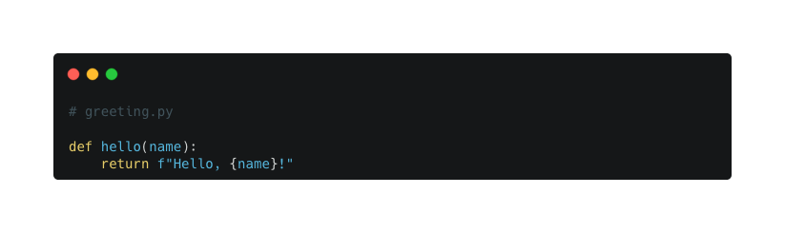
02 - Python Modules
1. Creating a Basic Module:
Let's begin by creating a Python file, which we'll treat as a module. Name this file greeting.py.
‹#›

Slide 13
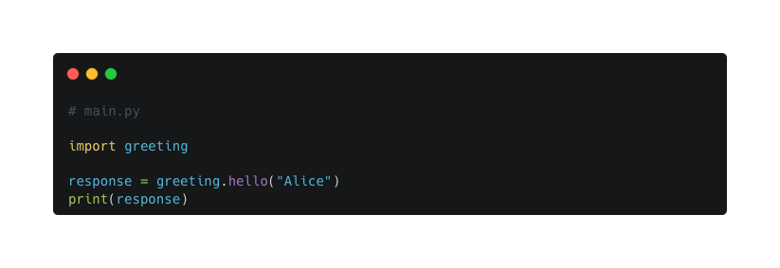
02 - Python Modules
2. Importing a Module:
Now, let's assume you have another file named main.py in the same directory as greeting.py. Here's how you can import and use the hello function from the greeting module:
‹#›

Slide 14
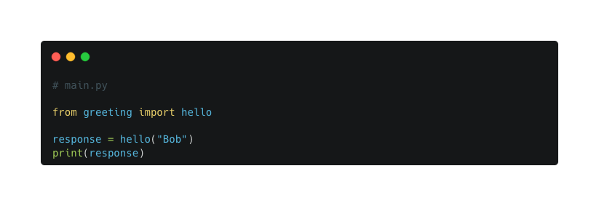
02 - Python Modules
3. Importing a Specific Function:
Instead of importing the entire module, you can just import the specific function:
‹#›

Slide 15
Introduction to Web Scraping
03

Slide 16
03 - Introduction to Web Scraping
Introduction to Python and Selenium
Web scraping is a method used to extract data from websites. Python, with its rich ecosystem, offers several libraries to facilitate this, one of which is Selenium. While primarily known for automating web applications for testing purposes, Selenium can be used effectively for web scraping tasks.
‹#›

Slide 17
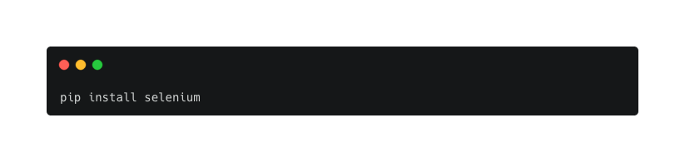
03 - Introduction to Web Scraping
Prerequisites
Python: Ensure Python is installed.
Selenium: Install Selenium using pip:
‹#›

Slide 18
03 - Introduction to Web Scraping
3. Web driver: Selenium requires a web driver to interface with a browser. Download the web driver for your preferred browser (Chrome, Firefox, etc.) and add its location to your system’s PATH.
‹#›

Slide 19
03 - Introduction to Web Scraping
3. Web driver: Selenium requires a web driver to interface with a browser. Download the web driver for your preferred browser (Chrome, Firefox, etc.) and add its location to your system’s PATH.
‹#›

Slide 20
Basic Web Scraping using Selenium

Slide 21
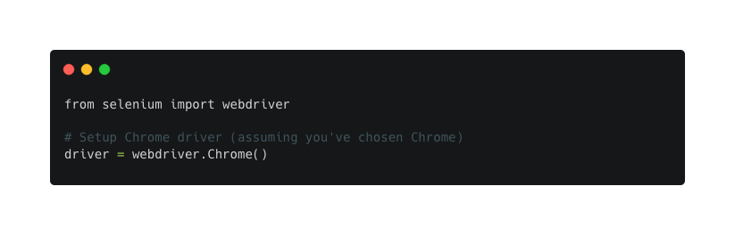
03 - Introduction to Web Scraping
1. Initialization:
First, set up Selenium to use the desired browser.
‹#›

Slide 22
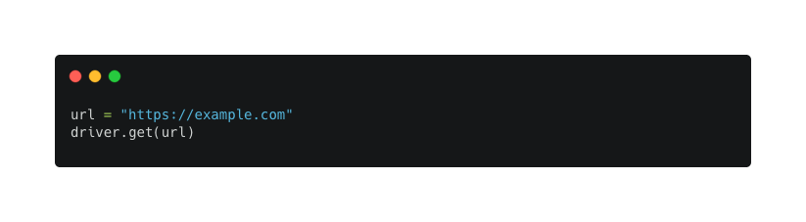
03 - Introduction to Web Scraping
2. Navigating to a Webpage:
Use the .get() method to navigate to a URL.
‹#›

Slide 23
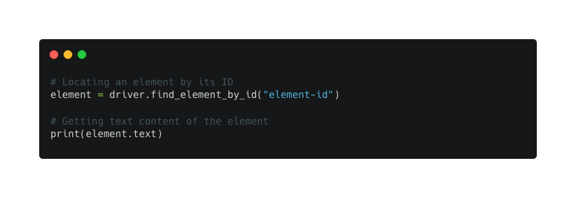
03 - Introduction to Web Scraping
3. Extracting Information:
Locate elements using various methods like find_element_by_id, find_element_by_name, etc. For multiple elements, methods like find_elements_by_class_name can be used.
‹#›

Slide 24
Handling Dynamic Content

Slide 25
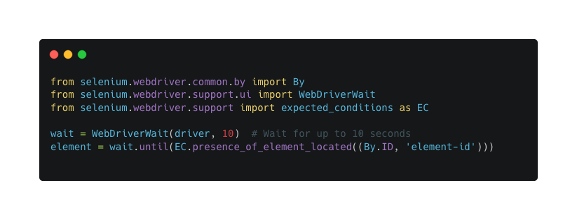
03 - Introduction to Web Scraping
1. Waiting for Elements:
Sometimes, you need to wait for elements to load. Selenium offers explicit waits for this.
‹#›

Slide 26
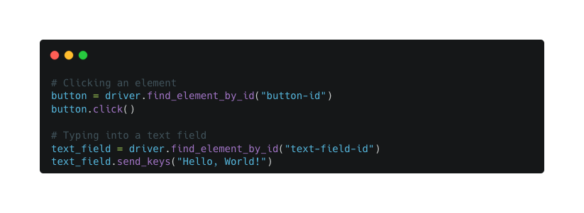
03 - Introduction to Web Scraping
2. Interacting with the Page:
You can simulate interactions like clicks, input text, etc.
‹#›

Slide 27
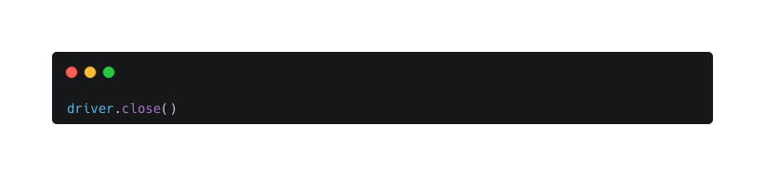
03 - Introduction to Web Scraping
Closing the Browser
Always remember to close the browser once your tasks are done.
‹#›

Slide 28
Thank you

